Slide 1
Tabs Vs. Spaces - The Greatest Battle of Our Time
Jason Bock
Practice Lead

Slide 2
Personal Info
http://www.magenic.com
http://www.jasonbock.net
https://www.twitter.com/jasonbock
https://www.github.com/jasonbock
jasonb@magenic.com

Slide 3
Downloads
https://github.com/JasonBock/TabsVsSpaces
https://github.com/JasonBock/Presentations/blob/master/Tabs%20Vs.%20Spaces%20-%20The%20Greatest%20Battle%20of%20Our%20Time.pptx

Slide 4
Overview
Overview
Data
Results
Conclusion
Remember…
https://github.com/JasonBock/TabsVsSpaces
https://github.com/JasonBock/Presentations/blob/master/Tabs%20Vs.%20Spaces%20-%20The%20Greatest%20Battle%20of%20Our%20Time.pptx

Slide 5
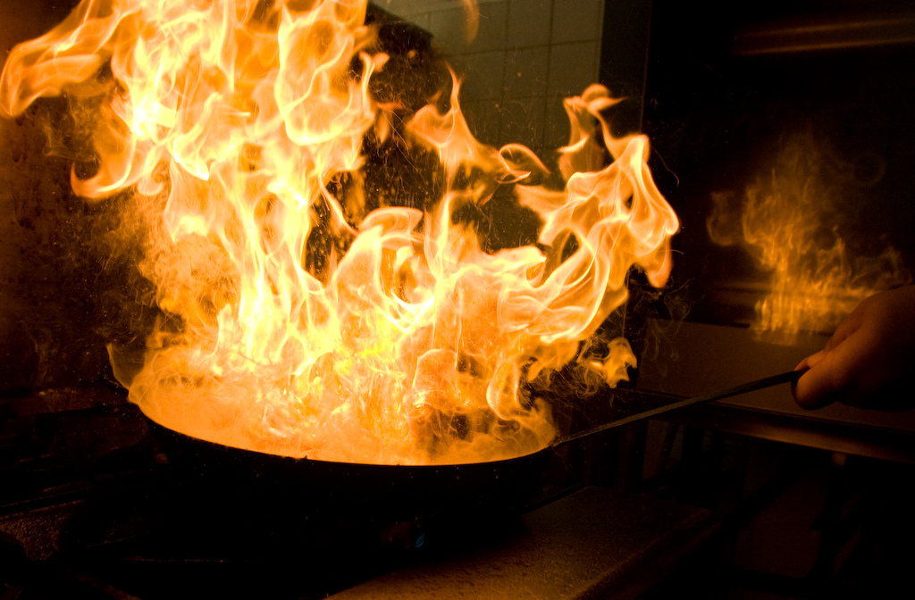
Overview
Put on your asbestos suits, folks. It’s gonna get hot in this kitchen.
https://c1.staticflickr.com/5/4107/5059831974_cf8c475aef_b.jpg
http://joshondesign.com/2014/09/02/bar
Notes:
If you want to start a fight of epic proportions in developer circles…

Slide 6

Overview
http://i5.asn.im/couple-arguing-_ucgr.jpg
Notes:
Tabs. Spaces. It is the biggest, thorniest problem we face in software development today. Forget language discussions and syntax arguments. Forget cloud provider debates. THIS is where the battle rages.

Slide 7
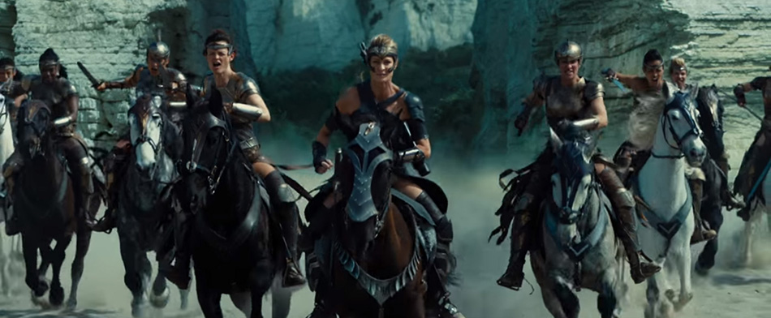
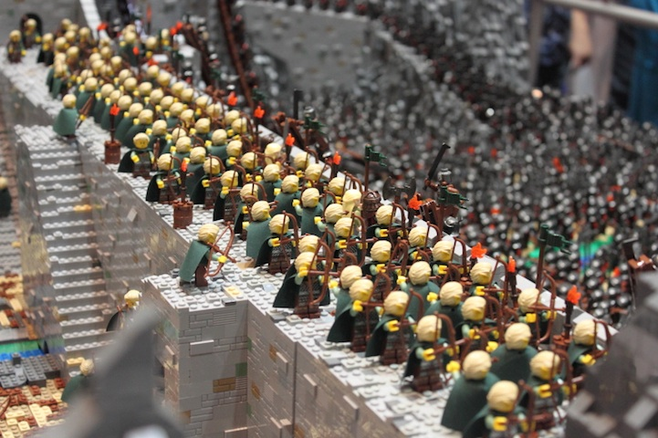

Overview
http://www.actionmoviefreak.com/images/action-movie-blog/wonder-woman-warriors-ride-into-battle.jpg
http://trendbump.com/wp-content/uploads/2013/10/lotrlegobuild11.jpg
http://www.agniinteractive.com/wp-content/uploads/2011/05/war-scene.jpg
Notes:
In fact, it’s usually not just two people fighting – it’s all-out WAR!

Slide 8
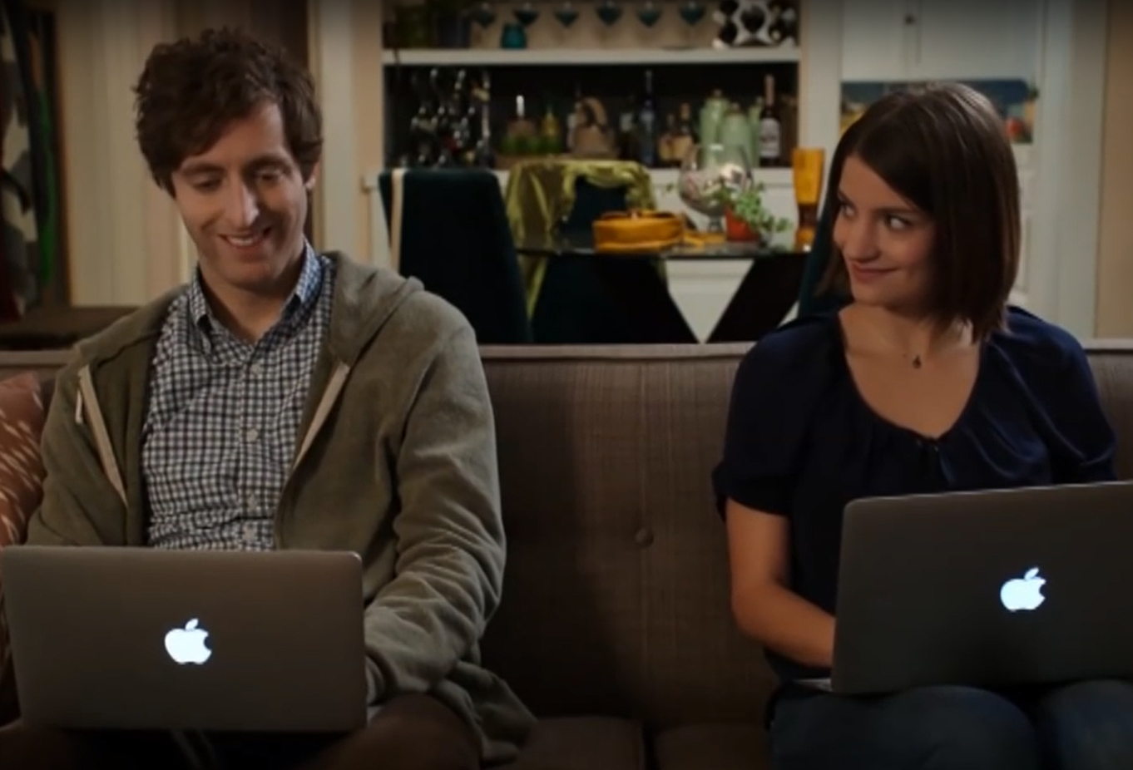
Overview
https://www.youtube.com/watch?v=SsoOG6ZeyUI
Notes:
Even Silicon Valley demonstrates how vicious this battle gets! (Side note: NOBODY manually enters spaces like what she does in the scene, that’s just crazy)

Slide 9
Overview
"Try cutting/pasting something that is tab based!" - http://jarrodoverson.com/blog/spaces-vs-tabs/
"To create nested lists, indent by one tab (or four spaces if you're antediluvian)." - http://www.macdrifter.com/2012/04/writing-in-markdown-lists.html
"...only a moron would use tabs to format their code.“ - https://blog.codinghorror.com/death-to-the-space-infidels/
"...we could try to merge the best of both worlds. Use tabs for indentation and spaces just for alignment" - https://blogs.msdn.microsoft.com/cyrusn/2004/09/14/tabs-vs-spaces/
Notes:
This is just a smattering of opinions about tabs and spaces on the internet

Slide 10
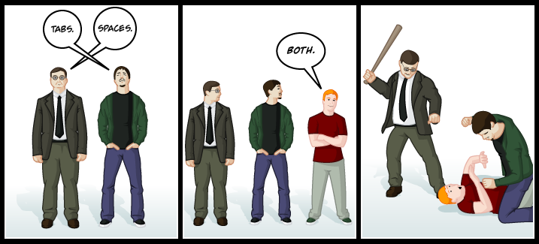
Overview
http://www.emacswiki.org/pics/static/TabsSpacesBoth.png
Notes:
By the way, that last bullet point? That’s crazy talk and we won’t talk about it further.

Slide 11
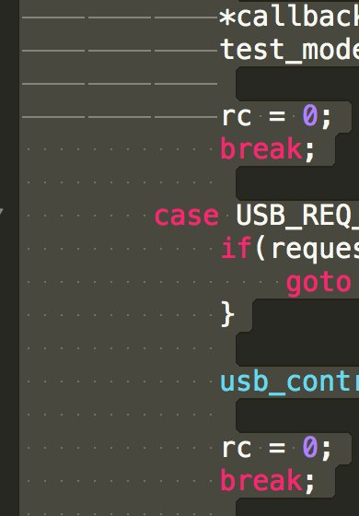
Overview
https://twitter.com/StackSmashing/status/961658232841400320
https://pbs.twimg.com/media/DVh-ti-WAAArU1A.jpg:large
Notes:
Side note: apparently Apple does this ☺

Slide 12
Data
"We could organise a battle to decide on tabs vs space, but nobody wins there."
https://github.com/DefinitelyTyped/DefinitelyTyped/issues/1709
Notes:
Now, whenever someone picks a side, there’s emotional baggage and opinions and frankly, they want to WIN!

Slide 13

Data
http://www.micfarris.com/wp-content/uploads/2011/10/Big-Data.jpg
Notes:
But we need data. We can’t just stick to an opinion with dogmatic ferocity and make any headway. This is true about performance. It’s one thing to speculate that a code change will be faster. It’s another if you can back it up with performance metrics.

Slide 14
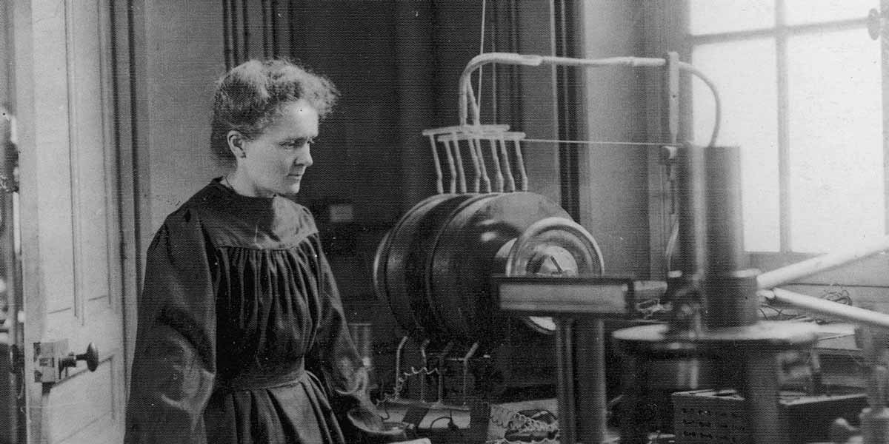


Data
http://www.rsc.org/diversity/175-faces/sites/175facesofchemistry/files/12_Marie_Curie_1200px.jpg
https://openclipart.org/image/2400px/svg_to_png/253954/radioactive-transparent.png
http://www.madlantern.com/blog/wp-content/uploads/2012/09/tombstone.png
Notes:
We also need to be objective as possible. Don’t sway the data with subjective biases. Be like Marie Curie….except with less radioactivity and dying ☺

Slide 15
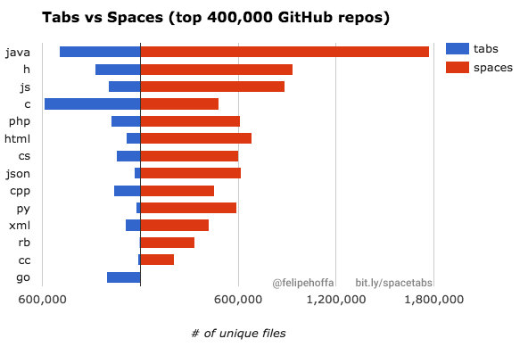
Data
https://medium.com/@hoffa/400-000-github-repositories-1-billion-files-14-terabytes-of-code-spaces-or-tabs-7cfe0b5dd7fd
Notes:
One version of this is popularity. But this only shows which one is being used more – it really doesn’t address the notion of which one is “better”.

Slide 16
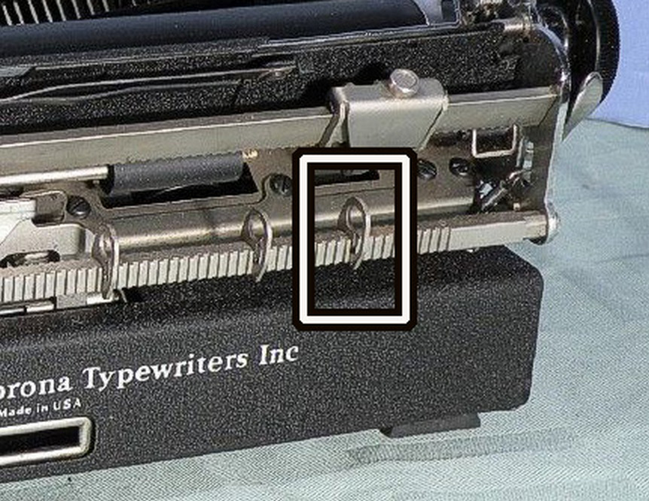
Data
The tabs stops could be adjusted to the indenting style of your particular document. Inherent is the concept that there is no “one right way”, but rather the format must suit the needs of the particular document, or part of a document, that you are writing.
http://joshondesign.com/2014/09/02/bar
Notes:
Let’s go back a bit. Tabs started with typewriters where you could set the size of the indention. “Tab stops”. Manually doing that with hitting the space bar is annoying (just like the Silicon Valley video clip shows).

Slide 17
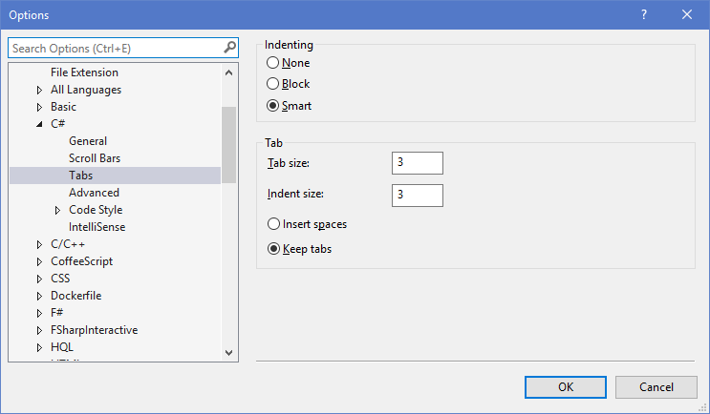
Data
Notes:
Indention is key to having well-formatted code that is readable. In modern IDEs, you can set the size of the indention to whatever looks good to you.
BTW notice the “Keep tabs” selection. That’s a hint as to what I prefer ☺

Slide 18
Data
namespace TabsVsSpaces
{
public sealed class Reformatter
{
s
s
s
t
Notes:
Another data point is file size. Note that if you use spaces, you’re going to end up using more characters than if you used tabs. And in these days of terabytes laptops and exabyte servers, this will add up! (That was being a bit sarcastic :), but tabs will make your file smaller.)

Slide 19

Data
namespace TabsVsSpaces
{
public sealed class Reformatter
{
s
s
s
t
https://github.com/dotnet/roslyn
Notes:
Also, think about the compiler. Even though whitespace is considered “trivia” – it’s literally called “SyntaxTrivia” in Roslyn – it still has to parse those characters. Wouldn’t it be more efficient to parse less characters?

Slide 20
Data
Git repos
Reformat
File Sizes
Compiler Benchmarks
Notes:
So, I decided to grab a bunch of OSS code, reformat it for tabs and spaces, get the file sizes, and then get benchmark numbers on the compilation times between them. Sounds easy? Well…not so much.

Slide 21
Data
Rocks (https://github.com/jasonbock/rocks)
Autofac (https://github.com/autofac/Autofac)
AutoMapper (https://github.com/AutoMapper/AutoMapper)
CSLA (https://github.com/marimerLLC/csla)
Moq (https://github.com/moq/moq)
Json.Net (https://github.com/JamesNK/Newtonsoft.Json)
AngleSharp (https://github.com/AngleSharp/AngleSharp)
NLog (https://github.com/NLog/NLog/)
NodaTime (https://github.com/nodatime/nodatime)
Notes:
To get data on file size and compilation time, I needed a bunch of projects. So I went to Github and pulled down repos from well-known projects (at least I think they’re well-known). I also made sure they could be compiled from VS 2017..

Slide 22
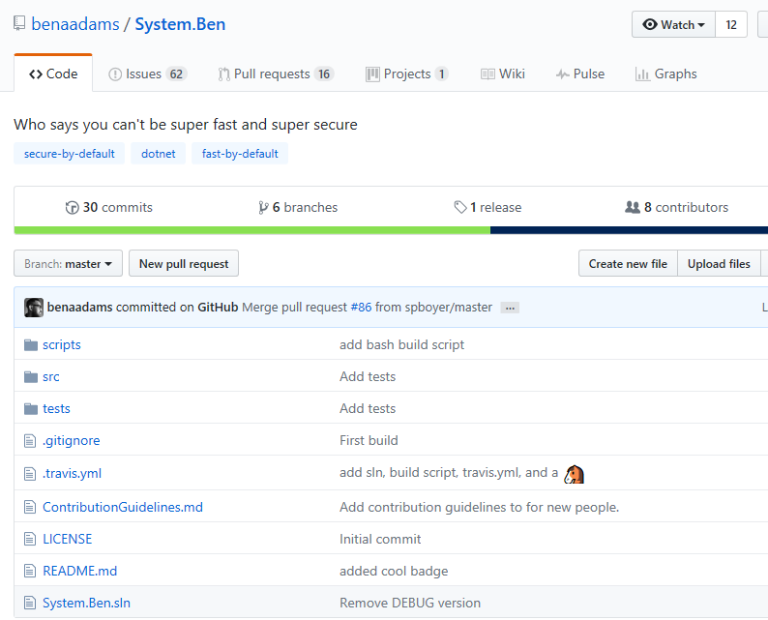
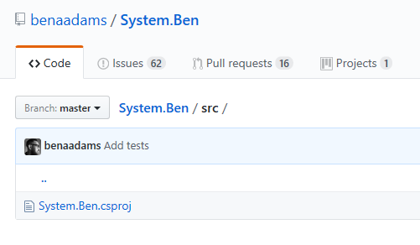
Data
https://github.com/benaadams/System.Ben
Notes:
I thought of using System.Ben as well, but….you know ☺

Slide 23
Data
Repos
Repo Name
Repo files
tab
space
Notes:
Then, I take each repo, and move them to a directory as two copies: “tab” and “space”

Slide 24
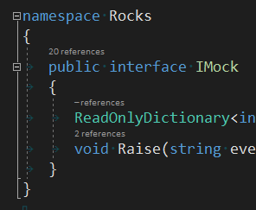

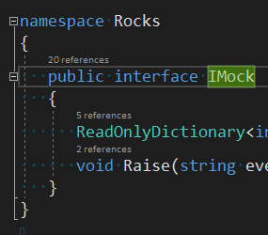
Data
.editorconfig
Repo Name
tab
space
Notes:
Each repo directory gets a custom .editorconfig file (wiping out any that currently exist), and then all .cs files are automatically formatted by driving a VS process.

Slide 25
Data
[Benchmark]
public async Task<ImmutableList<EmitResult>> BuildRocksWithTabs()
{
return await BuildTests.RunCompilation(
@"M:\TVSSource\Repos\Rocks\tab\Rocks.sln");
}
[Benchmark]
public async Task<ImmutableList<EmitResult>> BuildRocksWithSpaces()
{
return await BuildTests.RunCompilation(
@"M:\TVSSource\Repos\Rocks\space\Rocks.sln");
}
Notes:
Finally, each solution version is run through a compilation process and the times are calculated with Benchmark.NET. Actually, this changed from building from workspaces to MSBuild to just parsing C#.

Slide 26
Demo: TabsVsSpaces Code
Tabs Vs. Spaces - The Greatest Battle of Our Time
Notes:
Let’s do a quick walkthrough of the code.

Slide 27

Data
http://nimitdholakia.files.wordpress.com/2011/01/time.jpg
Notes:
As you can imagine, this took a lot of time to run. I don’t have exact numbers on the total time, but it’s some of the projects took hours to reformat.

Slide 28
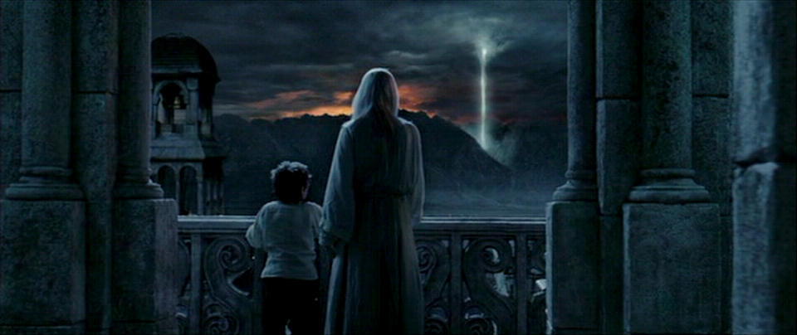
Results
"The board is set, the pieces are moving. We come to it at last, the great battle of our time." – Gandalf
Notes:
So, all the code has been downloaded, reformatted, and compiled. The question is….WHO WINS?

Slide 29
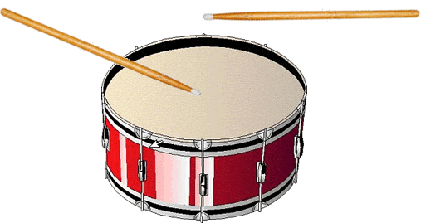
Results
https://helensrawfood.files.wordpress.com/2011/09/drumroll.gif
Notes:
Drum roll, please!

Slide 30
Results
Code Base | Tab Size | Space Size | Difference
CSLA | 7016146 | 7367056 | 4.76
Rocks | 752150 | 837804 | 10.22
Autofac | 343871 | 391364 | 12.14
AutoMapper | 1086824 | 1265043 | 14.09
Moq | 146647 | 165338 | 11.30
Newtonsoft.Json | 5332586 | 5978550 | 10.80
AngleSharp | 8582912 | 9631866 | 10.89
NLog | 3980119 | 4384745 | 9.23
NodaTime | 371130 | 423255 | 12.32
Notes:
For file size, it’s clear using tabs helps. On average you get about 10% reduction in size.

Slide 31
Results
Code Base | SyntaxFactory Tab Speed | SyntaxFactory Spaces Speed | SyntaxFactory Difference
CSLA | 7.356500 | 7.468900 | 1.50
Rocks | 1.183700 | 1.247000 | 5.10
Autofac | 0.689907 | 0.656159 | 4.90
AutoMapper | 1.288004 | 1.299830 | 0.91
Moq | 2.685695 | 2.664690 | 0.78
Newtonsoft.Json | 0.775628 | 0.792198 | 2.09
AngleSharp | 2.203796 | 2.233484 | 1.33
NLog | 1.218776 | 1.212346 | 0.53
NodaTime | 1.570425 | 1.576338 | 0.38
Notes:
For parsing times, it’s not as clear. Overall there seems to be some small gains using tabs but it’s not consistent.

Slide 32
Results
[Benchmark]
public ExpressionSyntax ParseWithTabs()
{
return SyntaxFactory.ParseExpression(" myObject != null");
}
SyntaxTrivia, Kind == SyntaxKind.WhitespaceTrivia
[Benchmark]
public ExpressionSyntax ParseWithSpaces()
{
return SyntaxFactory.ParseExpression(" myObject != null");
}
Notes:
I even went so far to do tests just on parsing simple expressions with leading trivia. Note that in both cases, the trivia is represented by the same struct, which captures the span and the raw text.

Slide 33
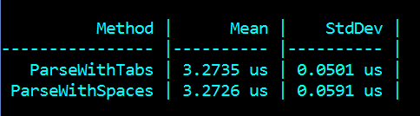
Results
Notes:
That’s why isn’t much of a difference, if any. The only difference is in reading the trivia and capturing it into the same kind of struct.

Slide 34
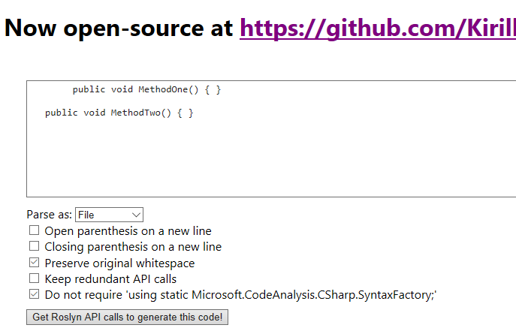
Results
Notes:
To really drive the point home, let’s use RoslynQuoter. The first line uses a tab, the second has three spaces.

Slide 35
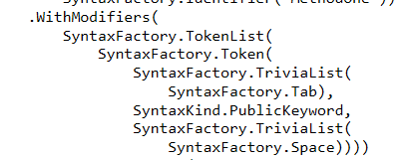
Results
Notes:
With the first one, it uses SyntaxFactory.Tab

Slide 36
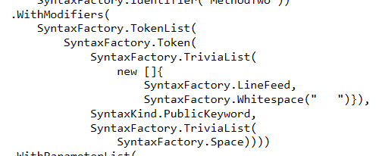
Results
Notes:
With spaces, it puts the space into the call.

Slide 37
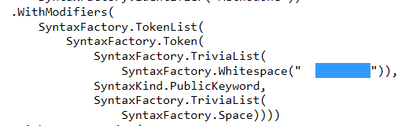
Results
Notes:
Note that if we increase the tab count to two, the call changes to having the tab within the Whitepace() call

Slide 38
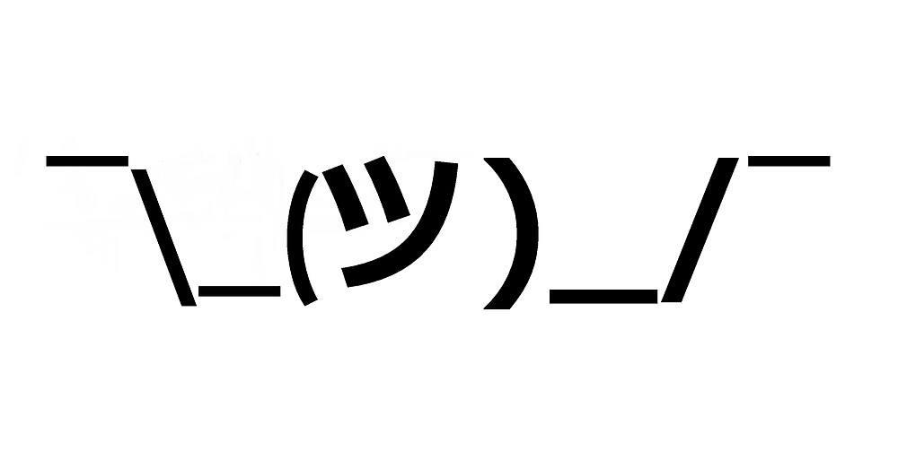
Conclusion
https://ih1.redbubble.net/image.91369793.6242/flat,1000x1000,075,f.jpg
Notes:
So, at the end of the day, it really doesn’t matter that much. Sure, file sizes do go down, but from a parsing perspective, it doesn’t seem to really matter much at all.

Slide 39

Conclusion
http://www.walkercreativedesign.com/wp-content/uploads/2011/01/Consistency-550x280.png
Notes:
The key is to be consistent, just like any formatting or practice choice. Don’t mix throughout a code base. There’s no point. Just stick with what’s there. And with .editorconfig files, it makes the choice pretty much irrelevant and specific to a particular code base.

Slide 40

Conclusion
https://happygoallucky.files.wordpress.com/2014/11/groupoffriendshugging.jpg
Notes:
So we can all get along, hug and be happy!

Slide 41
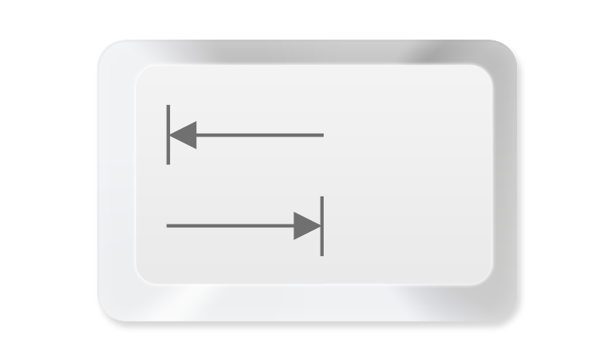
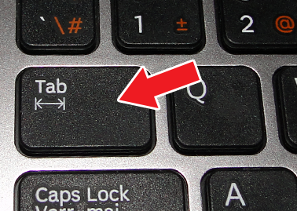


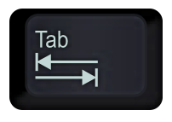
Conclusion
Notes:
Of course, I’m still sticking with tabs ☺

Slide 42
Tabs Vs. Spaces - The Greatest Battle of Our Time
Remember…
https://github.com/JasonBock/TabsVsSpaces
https://github.com/JasonBock/Presentations/blob/master/Tabs%20Vs.%20Spaces%20-%20The%20Greatest%20Battle%20of%20Our%20Time.pptx
References in the notes on this slide
Jason Bock
Practice Lead
Notes:
http://joshondesign.com/2014/09/02/bar
https://lostechies.com/jimmybogard/2012/03/07/tabs-versus-spaces-spaces-won/
http://jarrodoverson.com/blog/spaces-vs-tabs/
http://softwareengineering.stackexchange.com/questions/57/tabs-versus-spaces-what-is-the-proper-indentation-character-for-everything-in-e
https://twitter.com/ThePracticalDev/status/737185546020126720
https://www.jwz.org/doc/tabs-vs-spaces.html
https://www.youtube.com/watch?v=SsoOG6ZeyUI
https://blogs.msdn.microsoft.com/cyrusn/2004/09/14/tabs-vs-spaces/
https://medium.com/@hoffa/400-000-github-repositories-1-billion-files-14-terabytes-of-code-spaces-or-tabs-7cfe0b5dd7fd#.anu4uru0u
https://github.com/DefinitelyTyped/DefinitelyTyped/issues/1709
https://blog.codinghorror.com/death-to-the-space-infidels/

